Slide 1
Mengwen He <mengwenh@andrew.cmu.edu> Emily ruppel <eruppel@andrew.cmu.edu> Iljoo Baek <ibaek@andrew.cmu.edu>
Gait Monitoring System
- SAFEWALK -
Wireless Sensor Network 18-748 March 8th, 2017

Slide 2
Agenda
Problem / Solution / Use Case
System Configuration
Goals and Technical components
Demo Plans
Role & Responsibility
Schedule

Slide 3
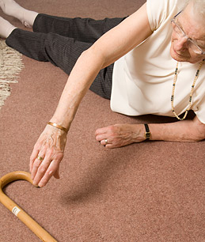
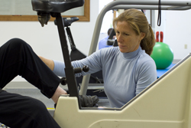

Problem
Elder Family Member
Physical Therapist (PT)
Family
Falls frequently
Lives with constant fear
Faces long-term medicalization

Slide 4
Problem
Elder Family Member
Physical Therapist (PT)
Family
It would be very beneficial for me to know what activities my patients engage in outside of their therapy sessions. It is not enough for a patient to follow recommended exercises during their sessions if they do not practice them…

Slide 5
Problem
Elder Family Member
Physical Therapist (PT)
Family
Little time with elder family member
Fearful of family member falling

Slide 6
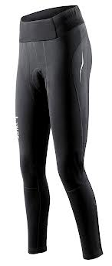
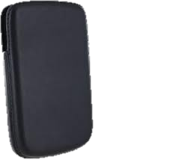
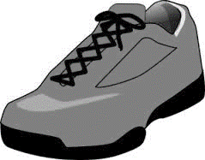
Solution
SafeWalk
Measures Gait using wireless sensor network
Helps Doctor/Physical Therapist monitor patients

Slide 7


Gait Measurement Parameters
Knee extension
Stride length
Gait Speed, Cadence, Double Stance Time, Swing Time, Swing Time Variability, Cadence Variability, Chair Time Rise, Ability to do Tandem Stance, Lower extremity muscle strength
Notes:
Add data source
Proprioception decreases and the muscles weaken

Slide 8
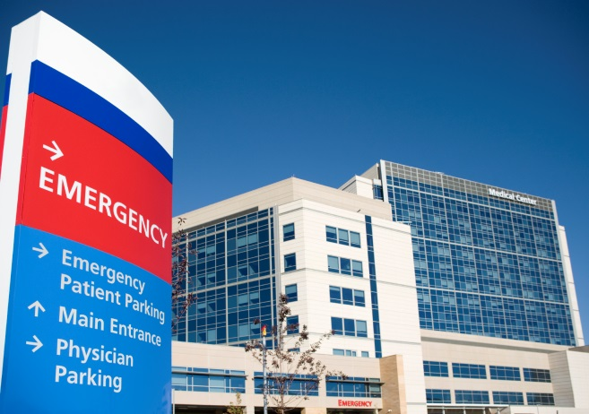
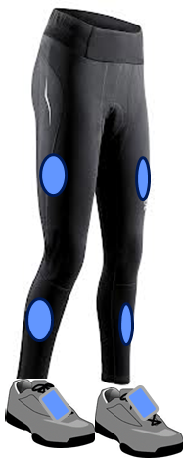

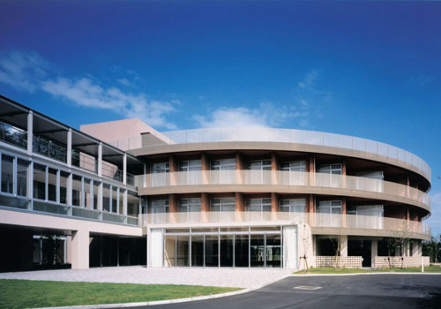
Use Case
Hospitals
SafeWalk
Patients
Nursing Homes

Slide 9
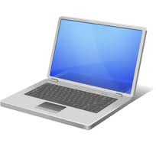
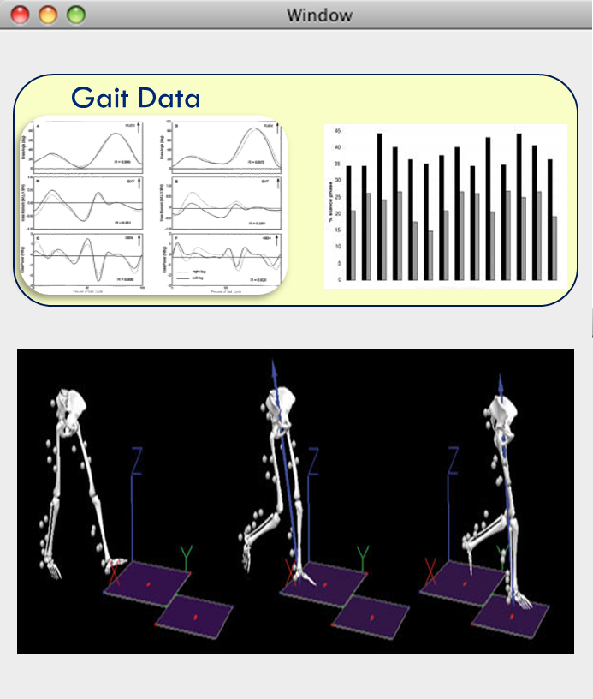
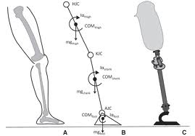
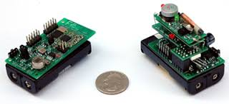
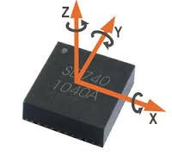
System Configuration
Data Server
Firefly
IMU
IMU
IMU | 6 EA
Firefly | 7 EA
PC | 1 EA

Slide 10
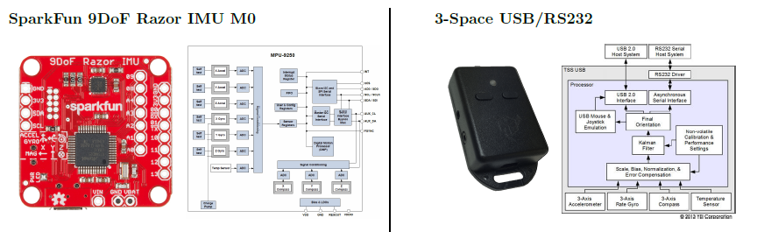
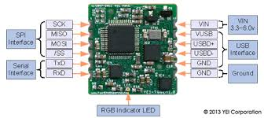
9-Axis IMUs Devices
Embedded IMU
Price: $50
Quantity: x6~4
Update rate: 100Hz
Built-in low-pass filter
Relatively low accuracy
Mount point: thigh + calf + (foot)
Price: $150
Quantity: x0~2
Update rate: 250Hz
Built-in Kalman filter
Relatively high accuracy
Mount point: (foot)

Slide 11
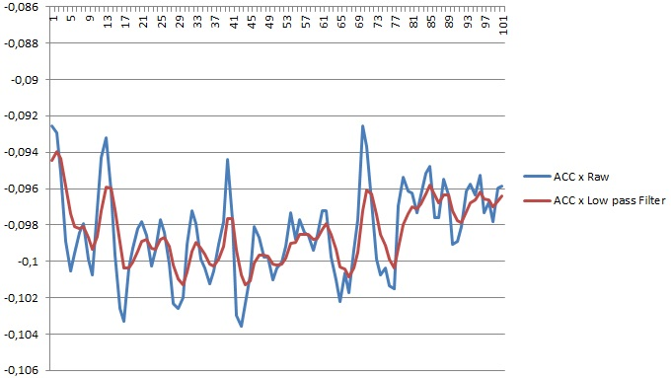
IMU Data Process
Noise cancellation & Estimation
Low Pass filter (a smoother)
Kalman Filter (a tracker to fuse acc+gyro with mag)

Slide 12
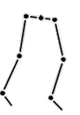

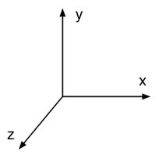
Multiple IMUs Calibration
Get IMUs’ Position & Orientation in a Unified Coordinate
Visualization
Gait data association

Slide 13






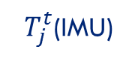
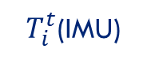
Calibration Method
Calibration Target: Initial (T=0) Position & Orientation
$$t=0$$
$$t$$
$T_{i}^{t}$(IMU)
$T_{j}^{t}$(IMU)
$$M_{i}^{0}$$
$$M_{j}^{0}$$
$$M_{i}^{0}T_{i}^{t}$$
$$M_{j}^{0}T_{j}^{t}$$

Slide 14









Calibration Method
Unified Coordinate for Calibration: Fixed Camera
$$t=0$$
$$t$$
$T_{i}^{t}$(IMU)
$T_{j}^{t}$(IMU)
$$M_{i}^{0}$$
$$M_{j}^{0}$$
$$M_{i}^{0}T_{i}^{t}$$
$$M_{j}^{0}T_{j}^{t}$$

Slide 15


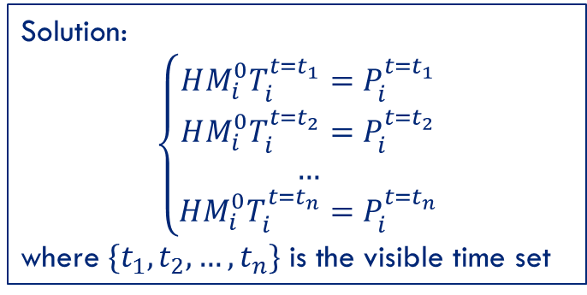


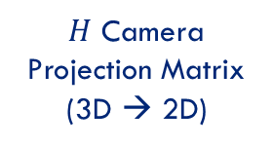
Calibration Method
Camera Based Calibration
$T_{i}^{t}$(IMU)
Solution:
$$\left\{\begin{aligned}HM_{i}^{0}T_{i}^{t=t_{1}}=P_{i}^{t=t_{1}} \\ HM_{i}^{0}T_{i}^{t=t_{2}}=P_{i}^{t=t_{2}} \\ … \\ HM_{i}^{0}T_{i}^{t=t_{n}}=P_{i}^{t=t_{n}}\end{aligned}\right.$$
where $\{t_{1},t_{2},…,t_{n}\}$ is the visible time set
$$M_{i}^{0}$$
$H$ Camera
Projection Matrix
(3D → 2D)
Keys:
Require tight time synchronization
Need as many paired data as possible
Need to handle IMU accumulated error
Time-weighted LSE
Manually locate IMU on images
CV track method is possible
RANSAC to get rid of wrong data
Invisible
Image
$$P_{i}^{0}$$
$$P_{i}^{t}$$

Slide 16
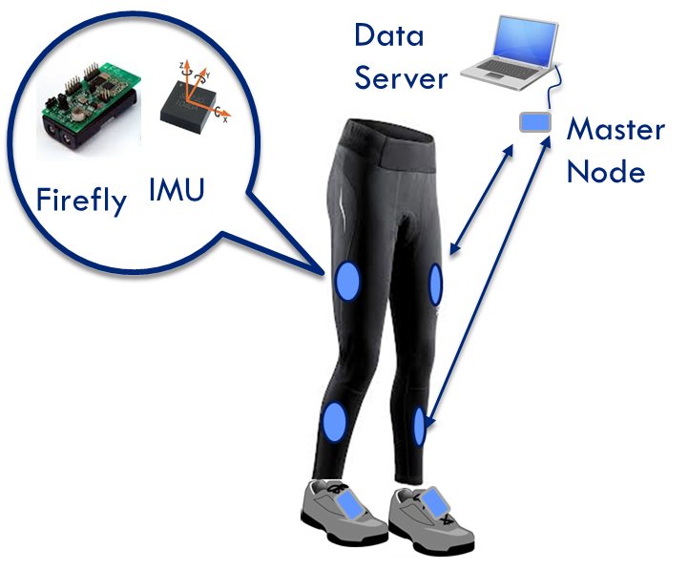
Data Communication
Master-to-slave
Packet loss detection
Synchronization
Data logging

Slide 17
Gait Data Analysis
Gait Speed
Cadence
Stride Length
Double Stance Time
Knee extension
Swing Time
Stride Length Variability
Swing Time Variability
Cadence Variability

Slide 18
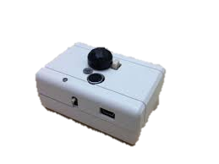
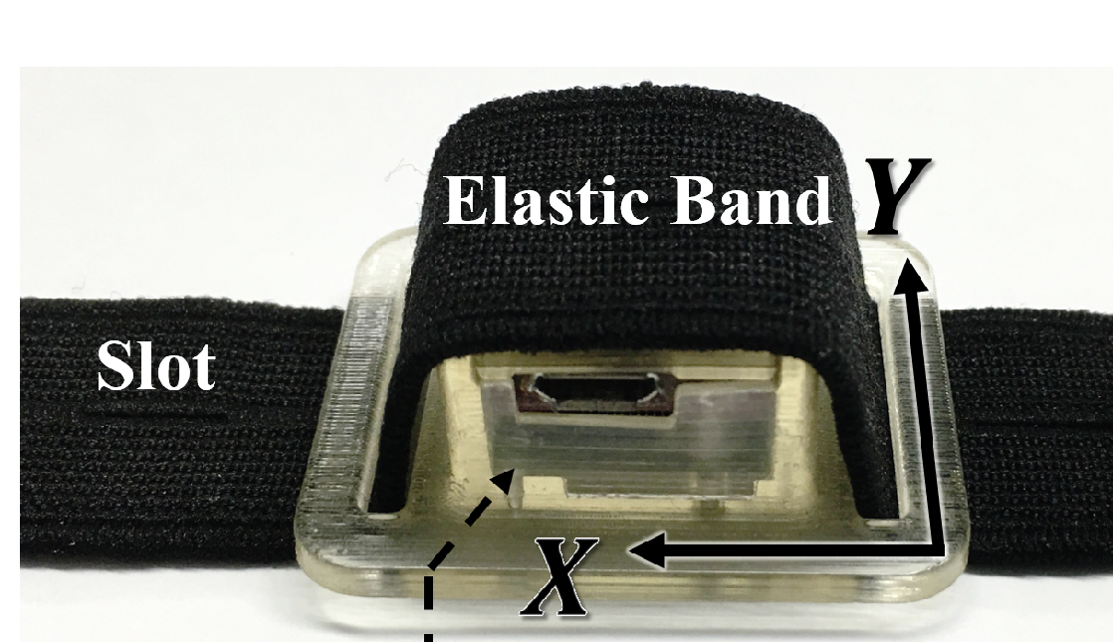
Fabrication
Sensor Enclosure box Design & Fabrication

Slide 19
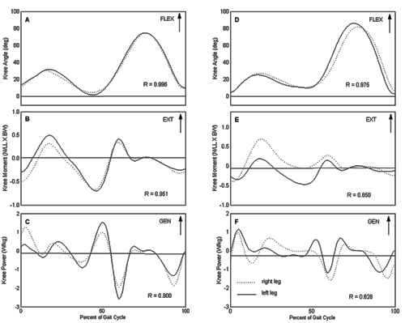
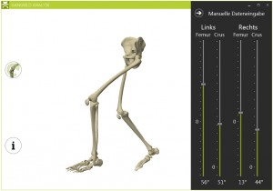
Visualization
Visualization
Data
Motion (Extra work)

Slide 20


Operating system
Firefly
IMU
Data server
…
Data Communication (Topology, Error recovery..)
Multiple IMU Calibration (Manual, Automatic)
IMU Data Process (Noise, Estimation etc.)
Gait Data Analysis
Visualization
Data Logging
Data Communication (Topology, Error recovery..)
Multiple IMU Calibration (Manual, Automatic)
IMU Data Process (Noise, Estimation etc.)

Slide 21
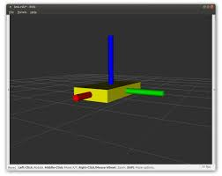
Intermediate Demo
Implement entire pipe line with single IMU
Data Server
Sensor node
Firefly
IMU
Data Communication
Single IMU Calibration
Single IMU Data Process
Data Communication
Single IMU Calibration
Single IMU Data Process
Visualization (Single IMU)

Slide 22
Intermediate Demo
Calibration with two IMUs

Slide 23
Final Demo
Multiple IMU Calibration

Slide 24
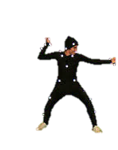

Final Demo
Live Real-time Demo
Real-time warning
Gait-Change Detection
Shunsuke

Slide 25
Role & Responsibility
EMILY
Communication between nodes
IMU to Firefly data transfer
Gait pattern analysis
ALEX
Multiple IMU Calibration
IMU Data Processing
Data transfer from master node to PC
ILJOO
Gait pattern analysis
Data visualization & logging
Enclosure fabrication

Slide 26
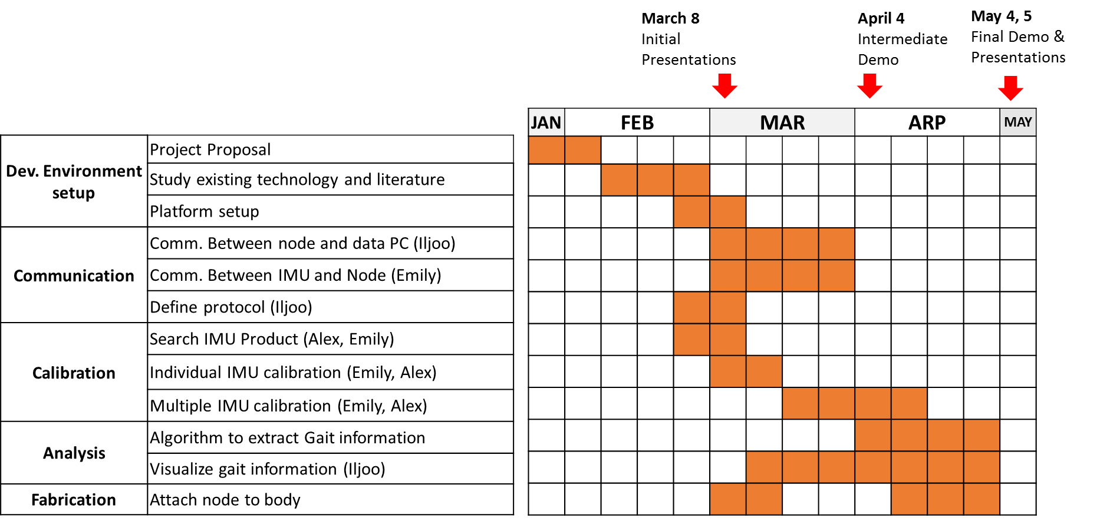
Schedule

Slide 27
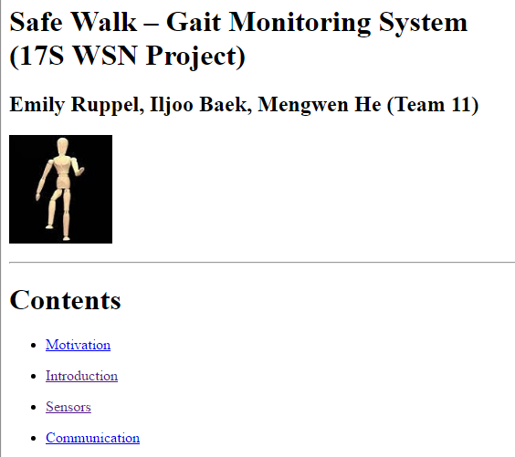
Project Website
https://17s-wsn-proj.github.io/Website/index.html

Slide 28
Reference
Anatomical Calibration through Post-Processing of Standard Motion Tests Data
http://www.mdpi.com/1424-8220/16/12/2011/htm
Gait Analysis Using Wearable Sensors
http://www.mdpi.com/1424-8220/12/2/2255/htm
Symbolic Modelling of Dynamic Human Motions
http://www.intechopen.com/books/biosensors/symbolic-modelling-of-dynamic-human-motions#
Assessment of walker-assisted gait based on Principal Component Analysis and wireless inertial sensors
http://www.scielo.br/pdf/rbeb/v30n3/03.pdf
Gait and Foot Clearance Parameters Obtained Using Shoe-Worn Inertial Sensors in a Large-Population Sample of Older Adults
file:///C:/Users/iljoo/Downloads/sensors-14-00443.pdf
Automatic pairing of inertial sensors to lower limb segments – a plug-and-play approach
https://www.degruyter.com/downloadpdf/j/cdbme.2016.2.issue-1/cdbme-2016-0155/cdbme-2016-0155.pdf

Slide 29
Q&A
Questions?

Slide 30
Appendix : Bandwidth
I2C
IEEE 802.15.4
UART
Data Server
IMU
Firefly x 6
Firefly
Master
Bottle neck
 | Data Name | Data type | Size (byte)
ID | ID | unsigned long | 4
Sequence | Seq | unsigned long | 4
Raw Data | TimeStamp | unsigned long | 4
 | accelX | float | 4
 | accelY | float | 4
 | accelZ | float | 4
 | gyroX | float | 4
 | gyroY | float | 4
 | gyroZ | float | 4
 | magX | float | 4
 | magY | float | 4
 | magZ | float | 4
quaternion | qw | float | 4
 | qx | float | 4
 | qy | float | 4
 | qz | float | 4
Euler angle | pitch | float | 4
 | roll | float | 4
 | yaw | float | 4
Total |  |  | 76
IEEE 802.15.4 : 250 Kbps = 32,000 bytes/sec
UART : 115,200 baud = 11,520 bytes/sec
One sample : 40 x 2 = 80 bytes
# of nodes : 6
IMU Freq (Hz) | Data (Bytes)
100 | 48,000
50 | 24,000
30 | 14,400
20 | 9,600

Slide 31
Appendix : Battery
2,800 mAH (@ 25ma) 1.5v x 2 (series)
Scenario 1: Firefly + Sparkfun 9DoF Razor IMU
Firefly node : 24.4 mA (Active + TX)
Sparkfun 9DoF Razor : 7.6 (Active)
Invensense MPU-9250 : 3.8 mA (Active)
Atmel SAMD21 : 3.64 mA (Active)
Total power : 32 mA (~4 days)
Scenario 2: Firefly + 3-Space Embedded IMU
Firefly node : 24.4 mA (Active + TX)
3-Space Embedded IMU: 45 mA (Active)
Total power : 70 mA (~1.5 days)

Slide 32
Appendix : Purchase List
Items to be purchased
Box Fabrication ($0)
Straps (<$20)
IMUs^{*)} ($50 x 4 + $140 x 2 = $480)
Battery (<$50)
Total : ~$550

Slide 33
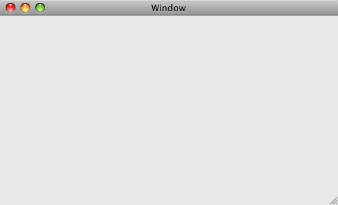

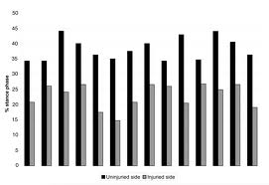

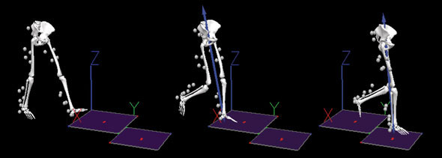


Appendix : Use Case Example
SafeWalk
Data Center
NAME
Mary
AGE
65
SEX
F
Gait Trends
Risk
PT Centers
Recommended Therapy
posture training :
strength training :

Slide 34



Appendix : Biz Model
Product
Service
Brand
Stand
Option
Customization

Slide 35
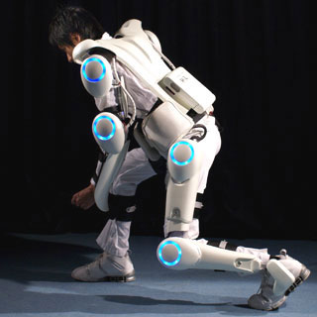
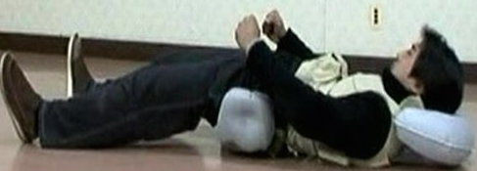
Appendix : Biz Model
Monitoring
Strength
Fall Characterization
Softer Falling
Fall Prevention
Protection
DATA
DATA

Slide 36
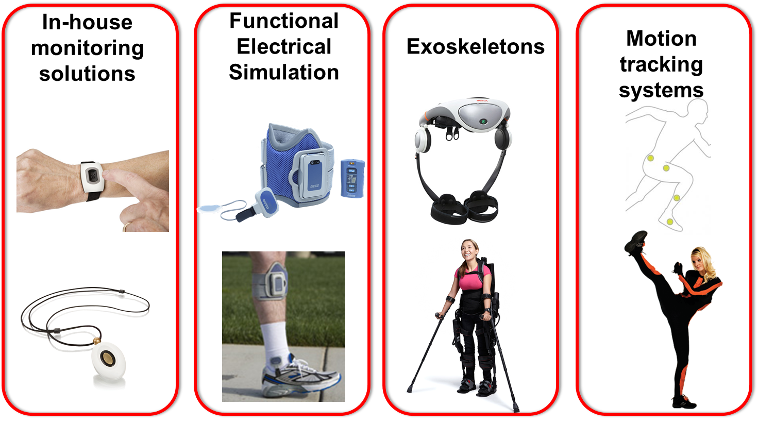
Appendix : Competitor

